Slide 1
Product Detector
Find genuine/fake product by scanning QR code on the bottle scratch label

Slide 2
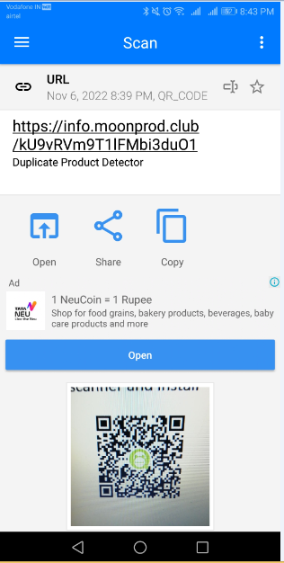
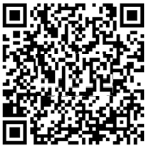
Find Genuine Product
Scratch the label on the bottle and scan the QR code using a
QR code scanner on your mobile. If you don’t have a scanner,
search for 'QR Code Scanner' on the Google Play Store and
install it.
Scan and open the link. If the product is genuine, the following page will be displayed

Slide 3
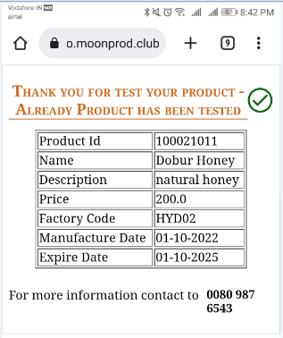
Genuine Product Screen

Slide 4
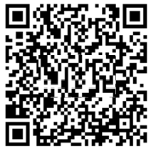
Find Fake Product
Scratch the label on the bottle and scan the QR code using a
QR code scanner on your mobile. If you don’t have a scanner,
search for 'QR Code Scanner' on the Google Play Store and
install it.
Scan then open. If it’s fake product then display below page.

Slide 5
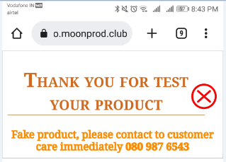
Fake Product Screen

